Slide 1
Empowering rangatahi
to live their best life

Slide 2
Employability Skills
What employers are looking for in young people

Slide 3
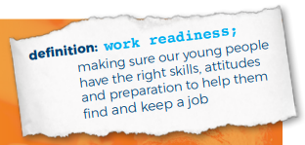
Employability skills are also known as:
Soft skills
Work readiness skills
Transferable skills

Slide 4
Employability skills:
Skills, qualities and attitudes that employers say are essential for their workplace.
Often considered just as (sometimes more!) important than qualifications and training.

Slide 5
There are many ways you can develop your employability skills.
You probably already have some, you just don’t realise it yet.

Slide 6
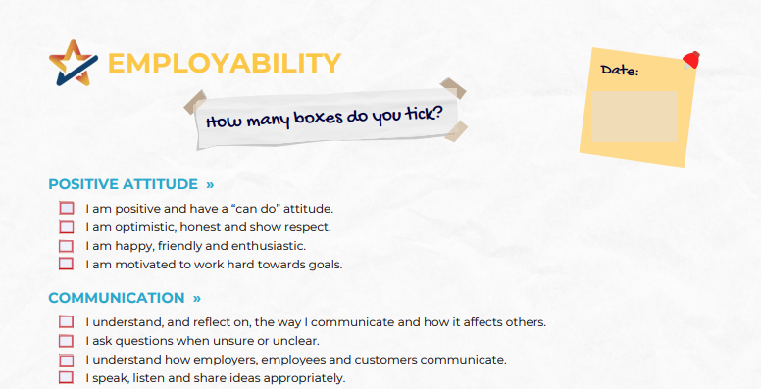
Student activity: How many boxes do you tick?
On the student worksheet: tick any description where you would answer ‘always’ or ‘most of the time’
(if your answer is ‘never’ or ‘sometimes’, leave it blank!)
https://smartnz.nz/wp-content/uploads/2022/04/endorseMe-Self-Assessment.pdf

Slide 7
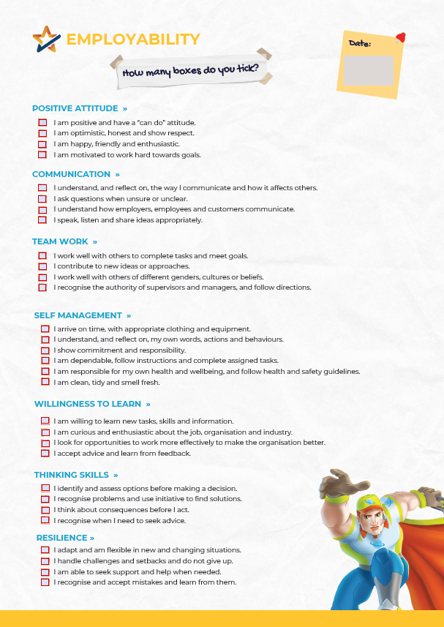
By working on developing these skills while you’re still in school, you will be setting yourself up for a successful future, whatever you decide to do.
IMPORTANT!!
Don’t worry if you haven’t ticked many boxes, it just means it’s an area to work on, and you’re not there YET!
Pat yourself on the back for the strengths you do have, and think about what you can do to develop the others
By working on developing these skills while you’re still in school, you will be setting yourself up for a successful future, whatever you decide to do

Slide 8
How did you do?
Which skills are you already nailing?
Which do you need to work on?
Circle one employability skill you want to work on improving this term
Write on the bottom of your sheet one thing you can do to practise this skill
I’m going to work on my self management skills by: getting my school bag and lunch packed at night rather than leaving it to the last minute in the morning.
Notes:
*Teacher note: If students are completing this activity digitally they will need to record this part of the activity elsewhere

Slide 9
SmartNZ has developed an app to record your employability skills to support future job applications
Coming soon to Hillcrest High School…

