Slide 1
Empowering rangatahi
to live their best life

Slide 2
A tool to help you plan your best life

Slide 3
Login to Career Central
Click student login
Select Hillcrest High School and enter your school user name and password

Slide 4
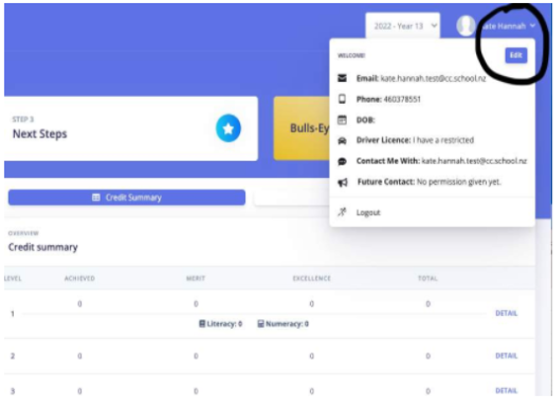
Step One
My Details:
Check your details on the top right of the dashboard and edit if required

Slide 5
Career Central is all about you – your interests, your journey, your goals.

Slide 6
During your time at High School, you will unlock new modules and revisit others to create your picture of your pathways.
Information gathered can be used in Learning Conversations with your teachers, career discussion with Careers Teachers and whaanau and to generate a CV.

Slide 7
As part of Hauora, you will learn to make Career Central fit you and your strengths and interests.
Your profile will follow you through your time at Hillcrest High School, changing and developing along with you.
It is a record of your learning about yourself and which pathways you may wish to explore in the future.

