Slide 1
Planning ahead:
What do I need to have in place before I leave school?
Empowering rangatahi
to live their best life

Slide 2
Quick Quiz!
When is the best time to think about what you’re going to need when you leave school?
After the summer holidays
The last week of school
Dunno, it’s ages away
Now

Slide 3
Why is ‘now’ the time to start thinking about what you need to have sorted by the time you leave school?

Slide 4
Do you know what you need to have sorted before you leave school?

Slide 5
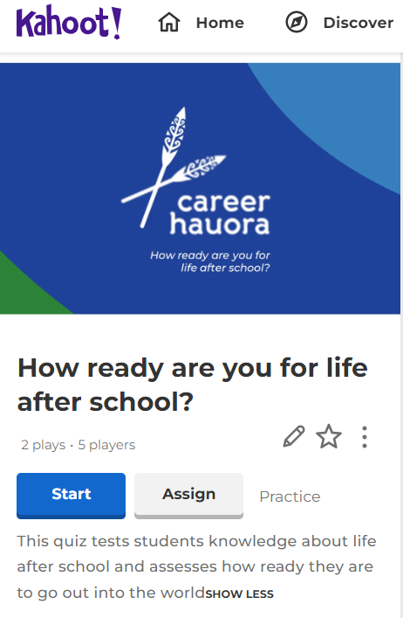
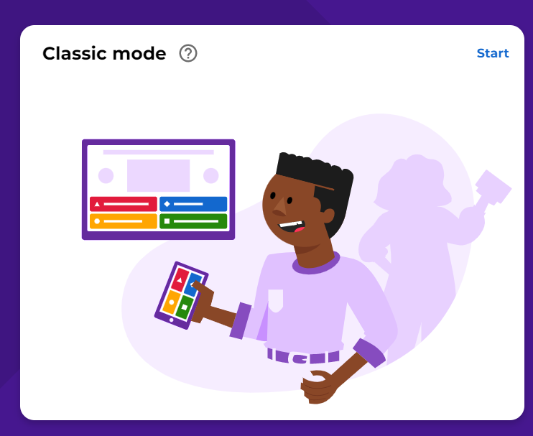
Teacher link:
https://create.kahoot.it/details/264aa919-e0c7-4d19-83a8-fc98aafd212e
Students:
www.kahoot.it
Notes:
Note to teachers: playing the Kahoot quiz is recommended, but optional. Slides 6-16 can be used either as a follow up discussion to the Kahoot or be used directly as discussion points.

Slide 11
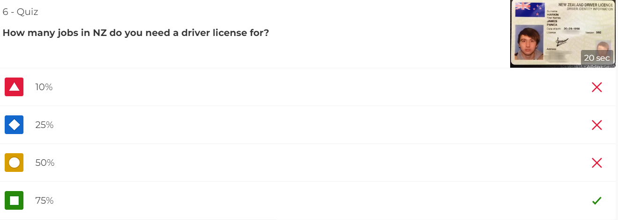

Slide 12
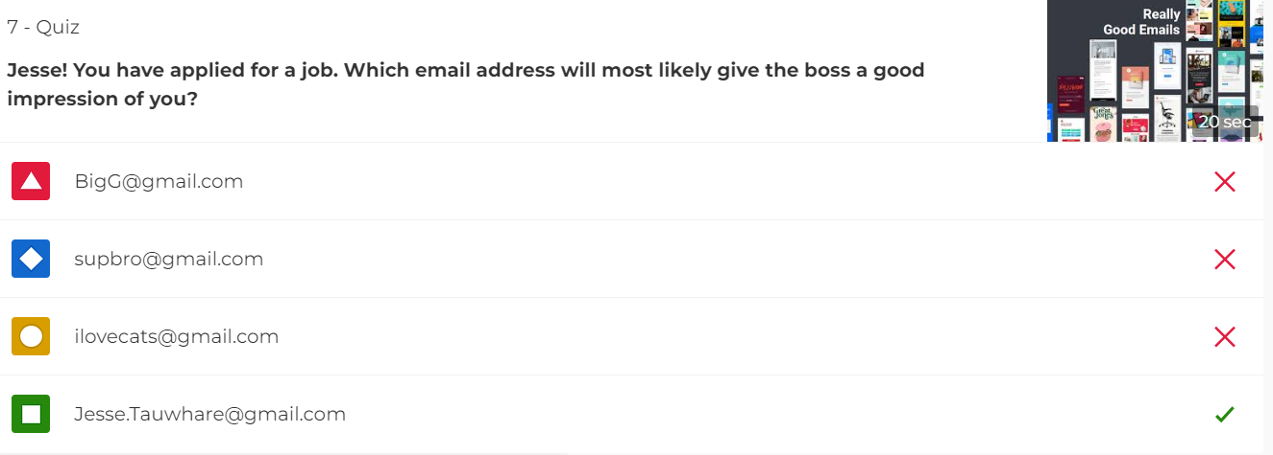

Slide 17
On Career Central there is a checklist of things of things to do or prepare before you leave school
It’s quite a long list, but don’t freak out!
Some items take 2 minutes to do (like create a sensible email address)
Some you can probably already tick off as ‘done’
Some take planning, time and money (e.g. getting a driver license)

Slide 18
Let’s see where you’re at…
Log into Career Central
Click on ‘Next Steps’
Complete the two sections:
My plans
Am I on Track
WAIKATO COLLEGE
Jesse James

Slide 19
How are you doing?
Don’t panic if you have a lot of things to do!
The trick:
start working on the easy things now
make a plan for how, and when, you’re going to tackle the others (we’ll be doing this in the next hauora session)

Slide 20
Homework:
Share the list with your caregivers
You will need their help to sort out some items
Have a chat about what they can (or can’t) do to help you

